Slide 1
Wi-Fi
Rex’s Wi-Fi Network
12345678
Computer
student
obe1
https://github.com/MyHiTeaTech

Slide 2
<HTML>
.CSS
My Hi-Tea Tech
29 September
Notes:
question?
speaking too fast?
interrupt if got question

Slide 3
What’s HTML and CSS?

Slide 4
<HTML>
.CSS
Style
Content

Slide 5
HTML
It’s all about the tags

Slide 7
Element

Slide 8
Element
Attribute

Slide 9
Content
Element
Attribute

Slide 10
HTML
An example

Slide 11
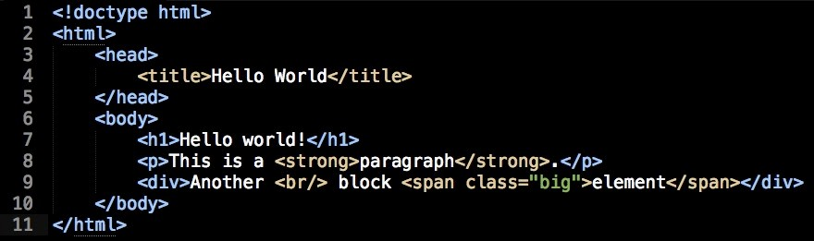

Slide 12
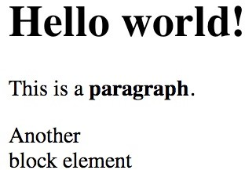

Slide 13
Structure first
What’s inside an HTML document?

Slide 14
<HTML>
The container

Slide 15
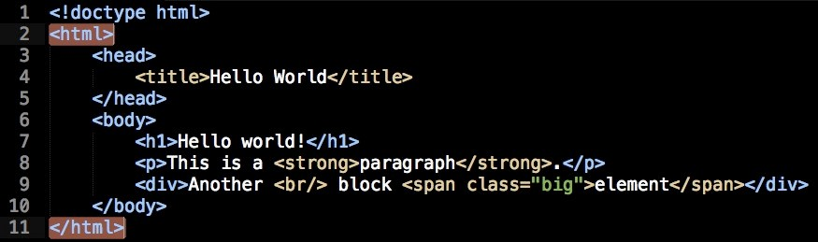

Slide 16
<HEAD>
The setup

Slide 17
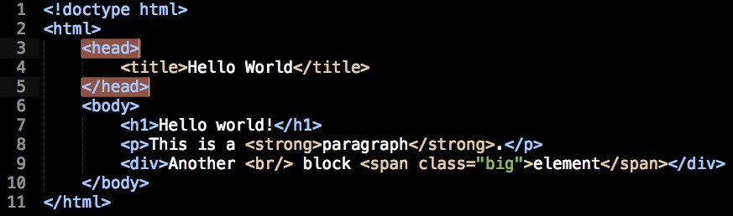

Slide 18
<BODY>
The content

Slide 19
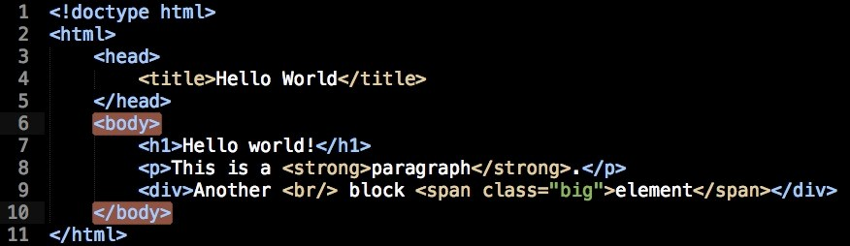

Slide 20
Writing the content

Slide 21
Block or Inline

Slide 23
Block
Inline

Slide 24
Block
Create a new line and occupy full width

Slide 25
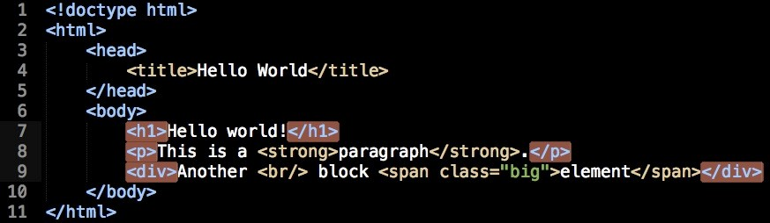

Slide 26
Inline
Keep the flow of the document

Slide 27
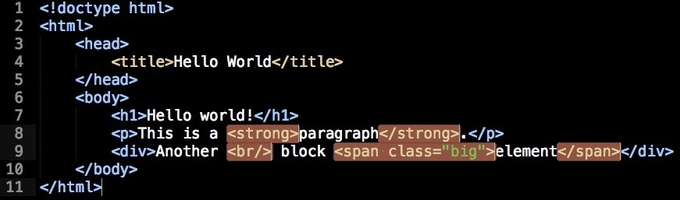

Slide 28
Usually work in pairs

Slide 30
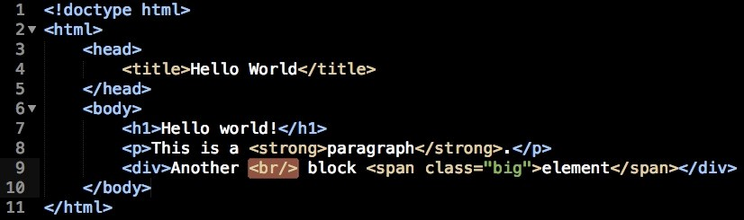

Slide 31
Most Important Elements
You’ll use these 90% of the time

Slide 32
<DIV>
The all-mighty block element

Slide 33
<SPAN>
The inline <div>

Slide 34
Paragraph is for text
<P>

Slide 35
<H1>
Headings from H1 to H6

Slide 36
<A>
Link to other pages or sections

Slide 37
But use them wisely

Slide 38
HTML is semantic

Slide 39
Tags have meanings

Slide 40
Don’t suﬀer from divitis

Slide 41
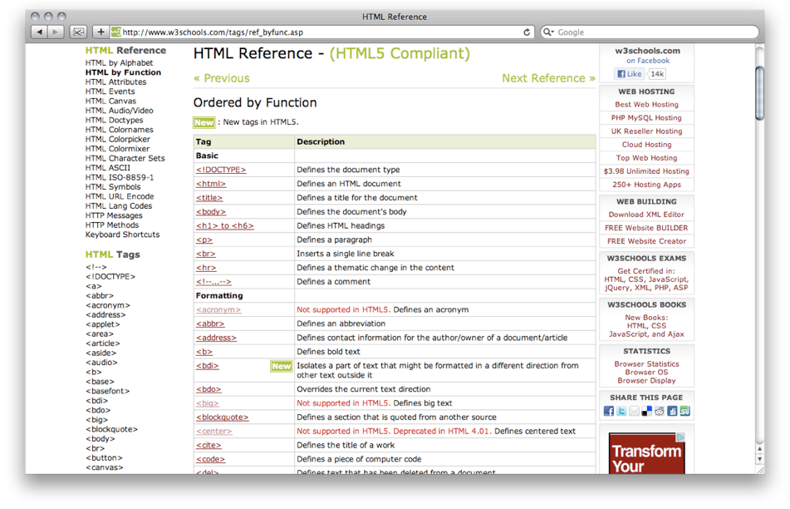

Slide 42
Start with the structure

Slide 43
Hello HTML5!

Slide 44
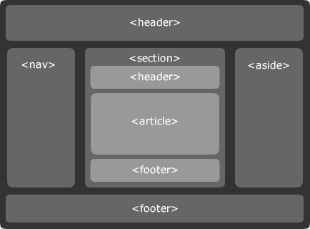

Slide 45
<HEADER>
Header for a document or section

Slide 46
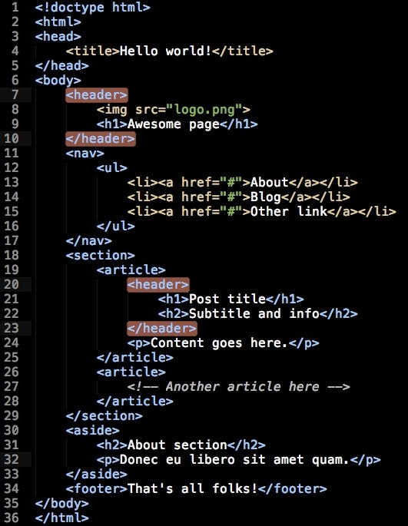

Slide 47
<NAV>
The new navigation menu

Slide 48
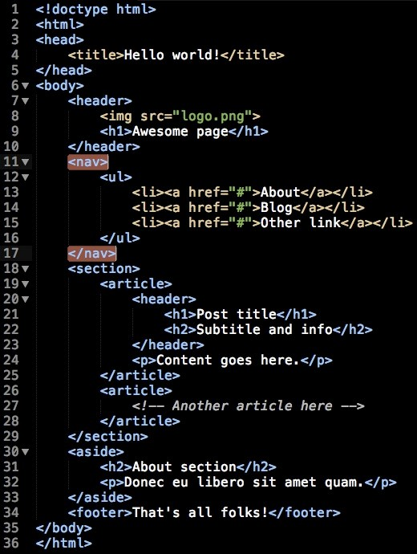

Slide 49
<SECTION>
The new <div>

Slide 50
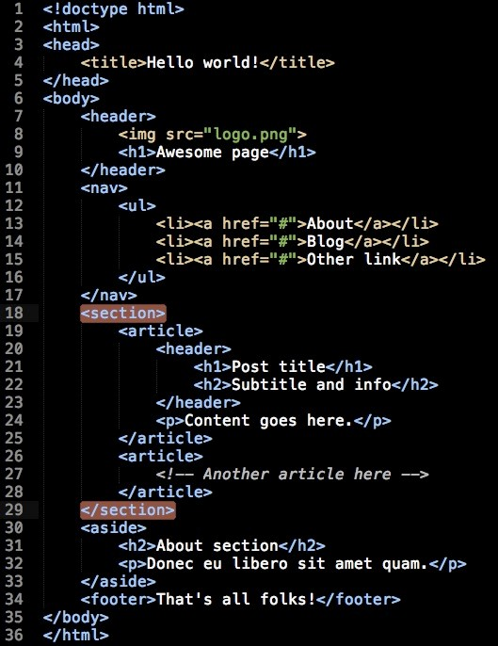

Slide 51
<ARTICLE>
Blog posts, news stories, comments

Slide 52
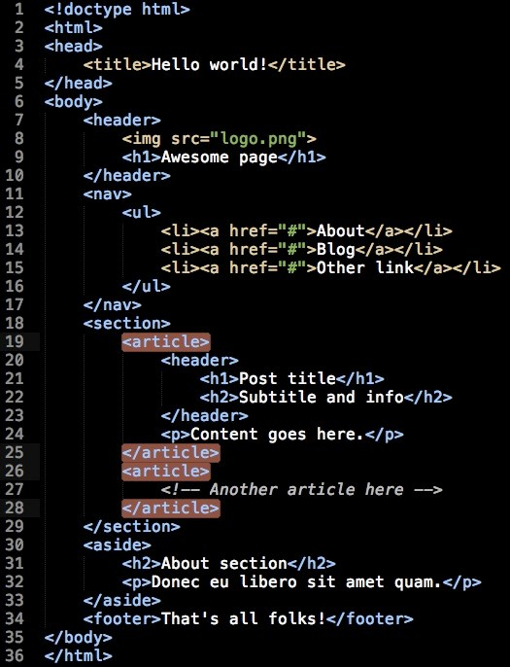

Slide 53
<ASIDE>
Related, but not really important content

Slide 54
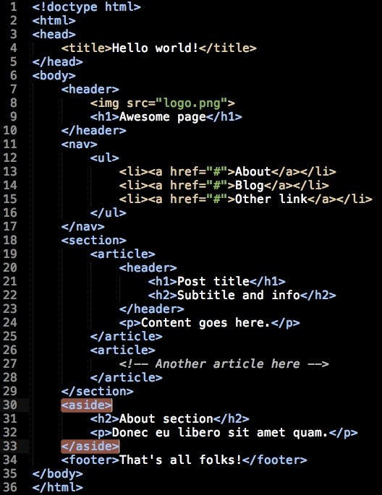

Slide 55
<FOOTER>
Footer for a document or section

Slide 56
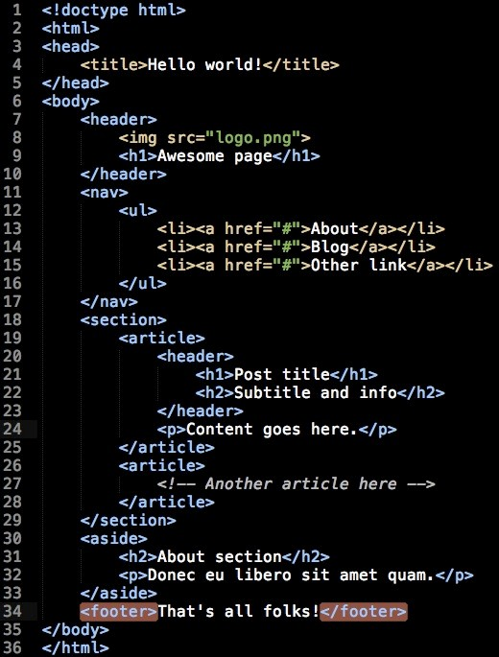

Slide 57
A real example

Slide 58
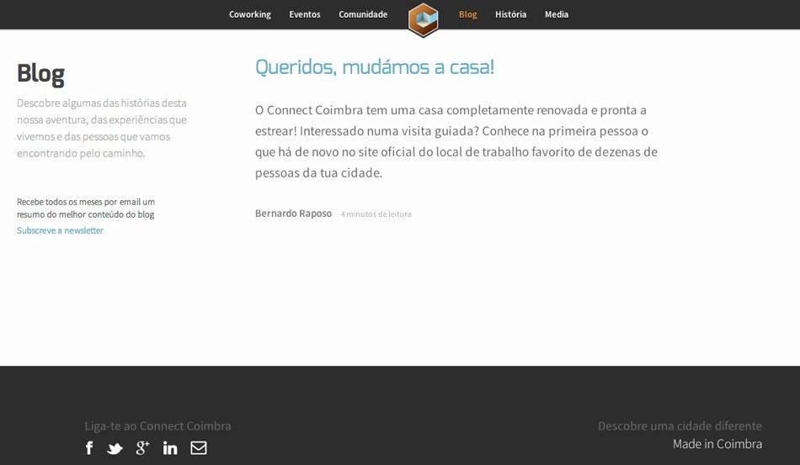

Slide 59
<header>

Slide 60
<nav>

Slide 61
<section>

Slide 62
<article>

Slide 63
<footer>

Slide 64
HTML resources

Slide 66
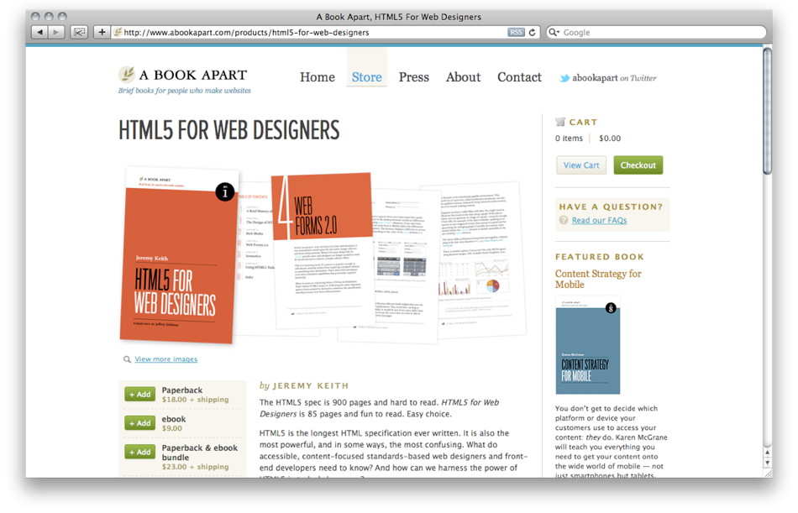

Slide 67
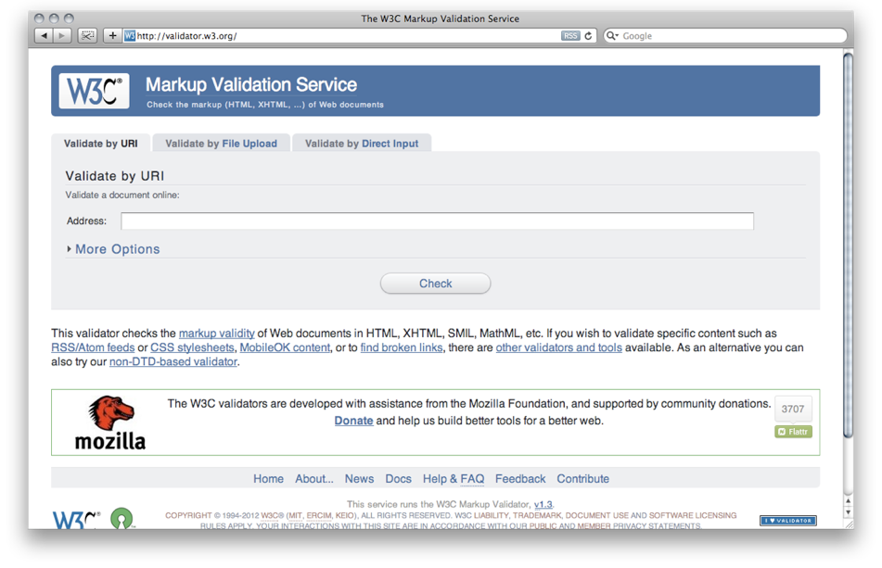

Slide 68
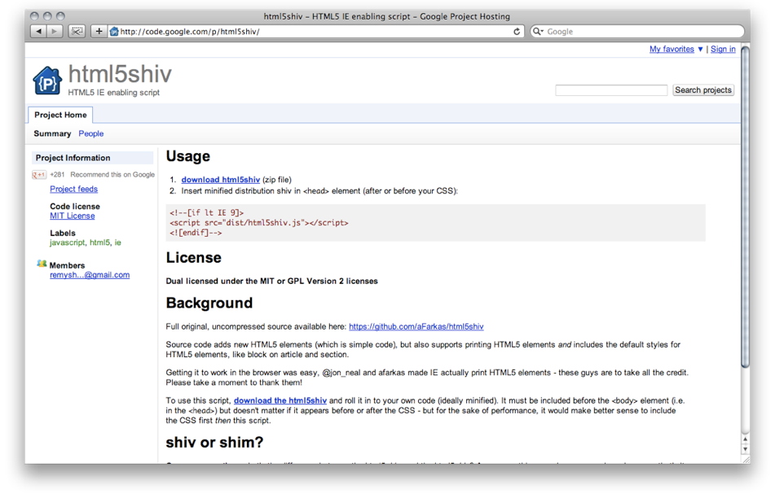

Slide 69
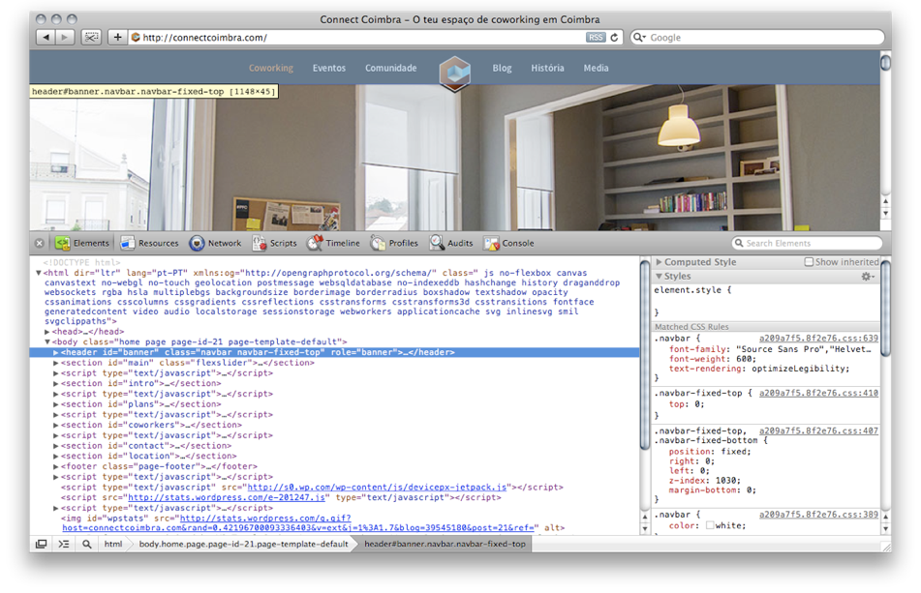

Slide 70
Let’s start styling!

Slide 71
Add the CSS to the page

Slide 72
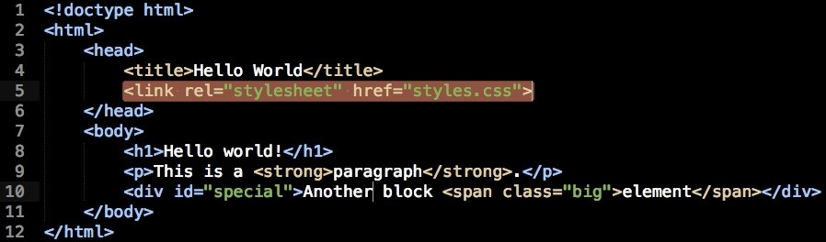

Slide 73
Selectors
Select element to style

Slide 74
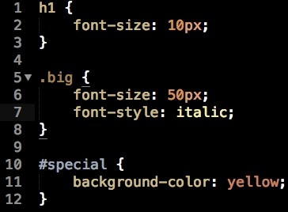

Slide 75
Tag
Class ID

Slide 76
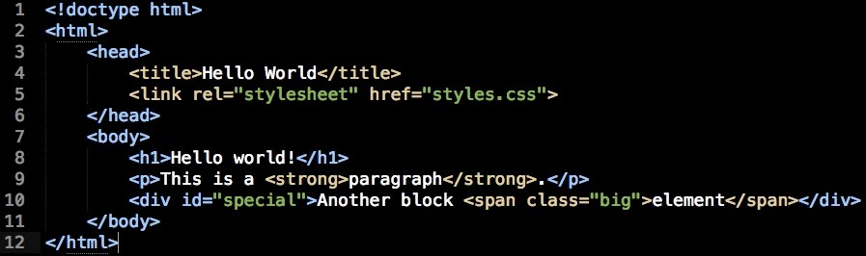
Tag
Class
ID

Slide 77
You can be very specific

Slide 78
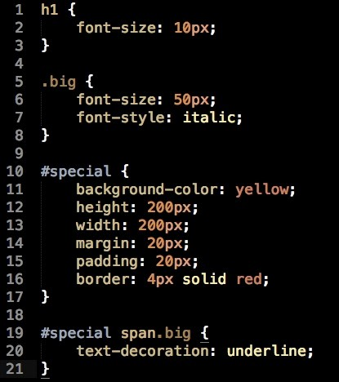

Slide 79
Be careful with the space

Slide 80
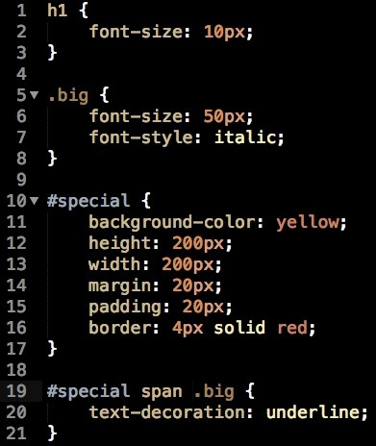

Slide 81
Properties
What do you want to change?

Slide 83
Values
Determine the behaviour of the property

Slide 85
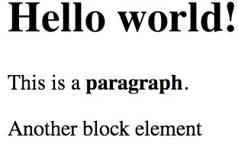

Slide 86
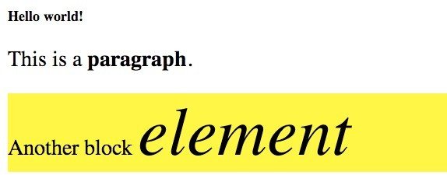

Slide 87
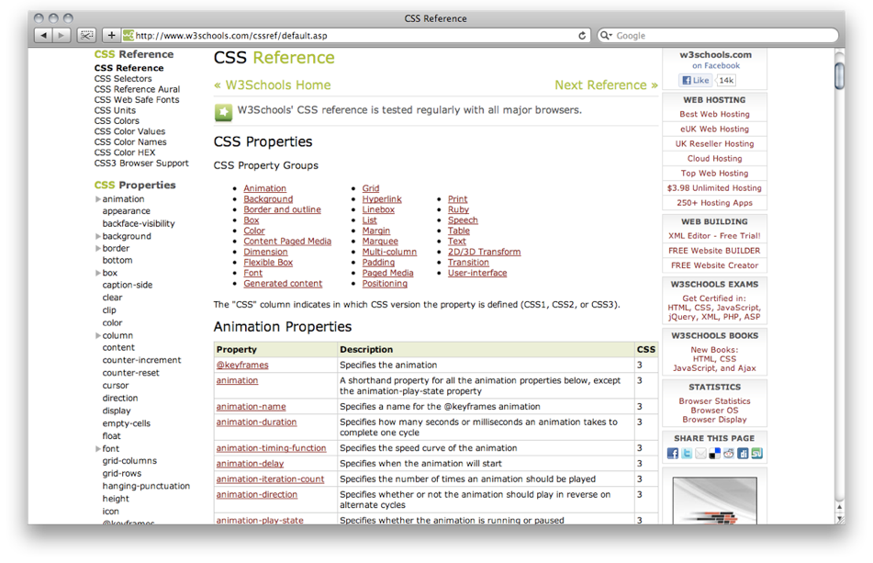

Slide 88
Browsers have custom styling

Slide 89
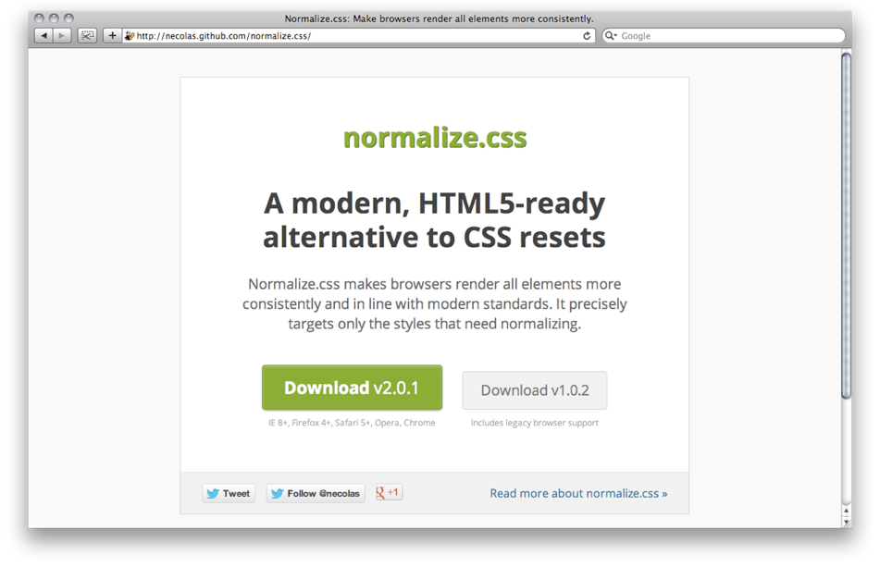

Slide 90
And custom properties

Slide 91
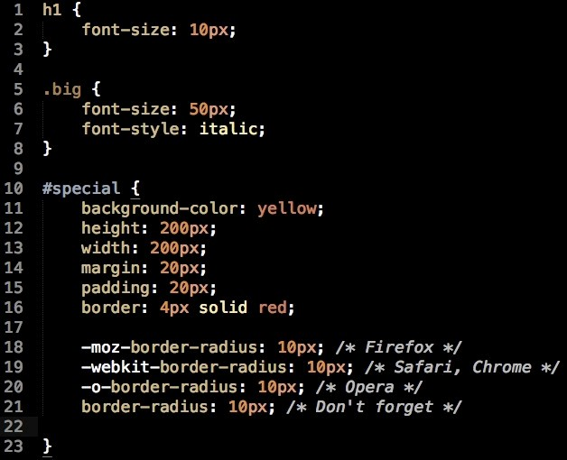

Slide 92
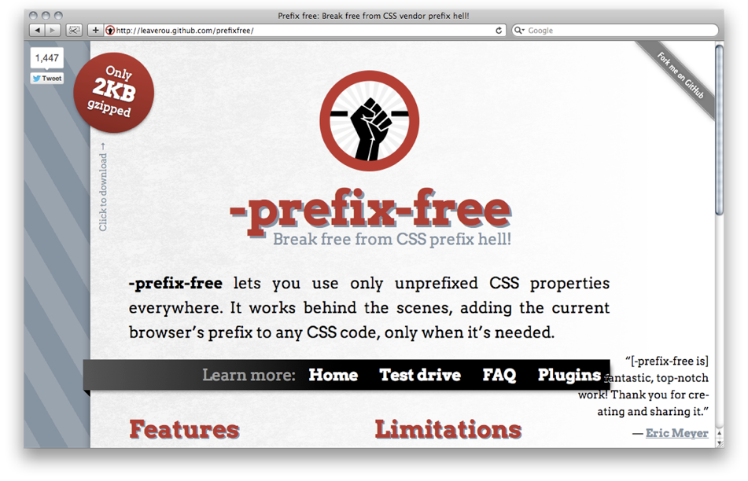

Slide 93
The box-model

Slide 94
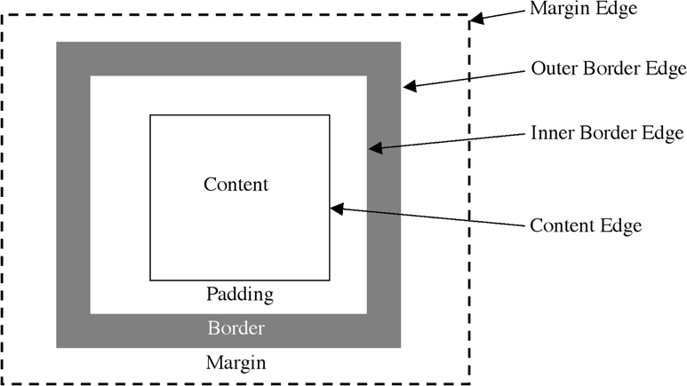

Slide 95
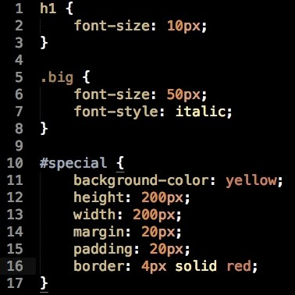

Slide 97
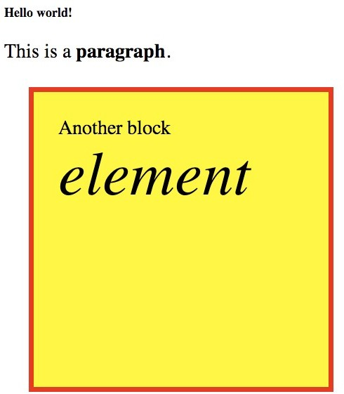

Slide 98
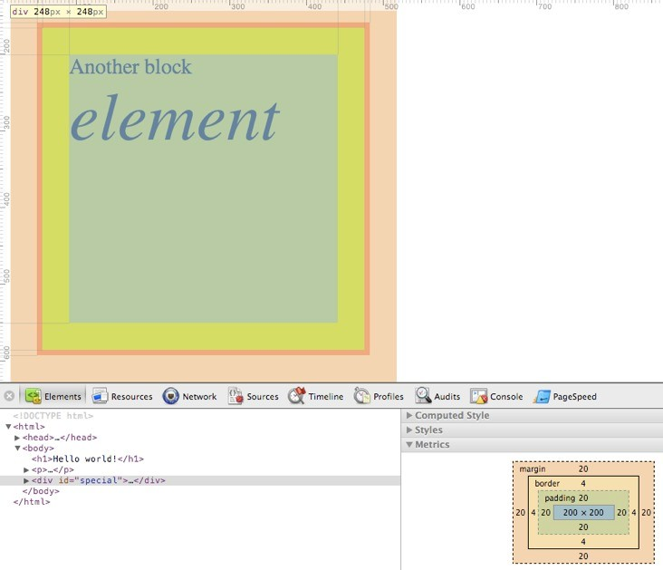

Slide 99
CSS can change everything

Slide 100
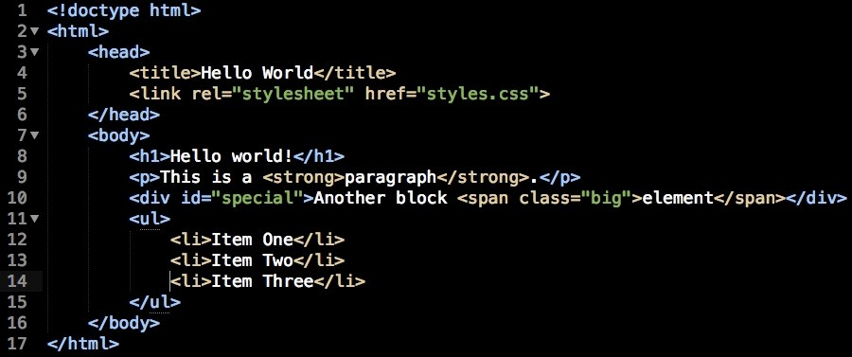

Slide 101
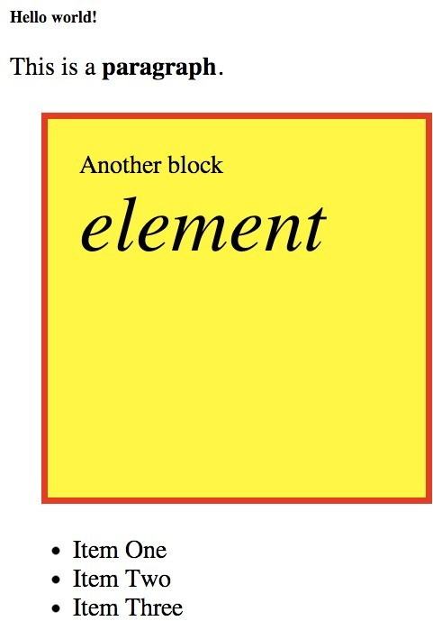

Slide 102
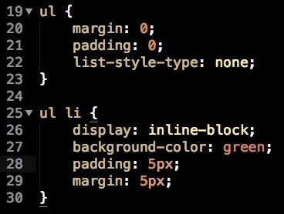

Slide 103
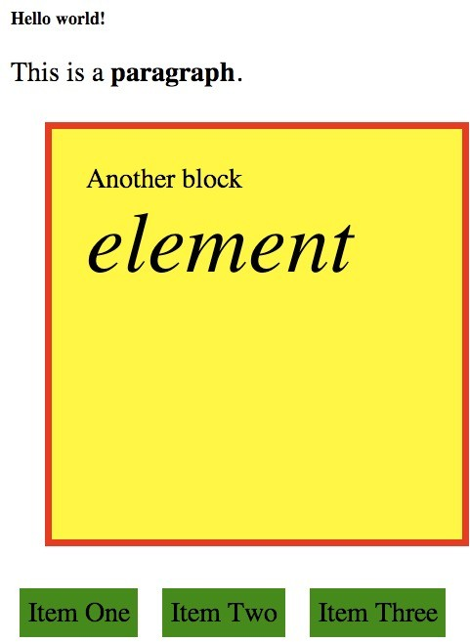

Slide 104
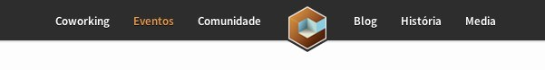

Slide 105
CSS3 is awesome

Slide 106
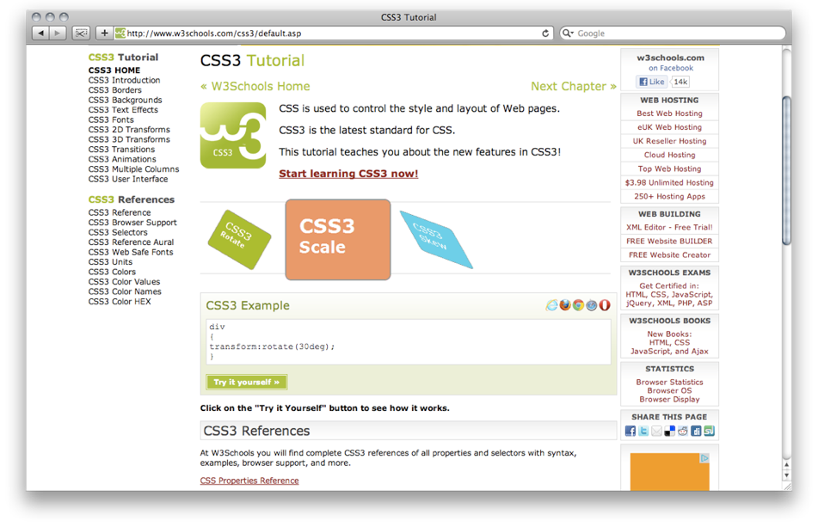

Slide 107
But Keep It Simple!

Slide 108
You don’t even need to work

Slide 109
There are tons of CSS frameworks

Slide 110
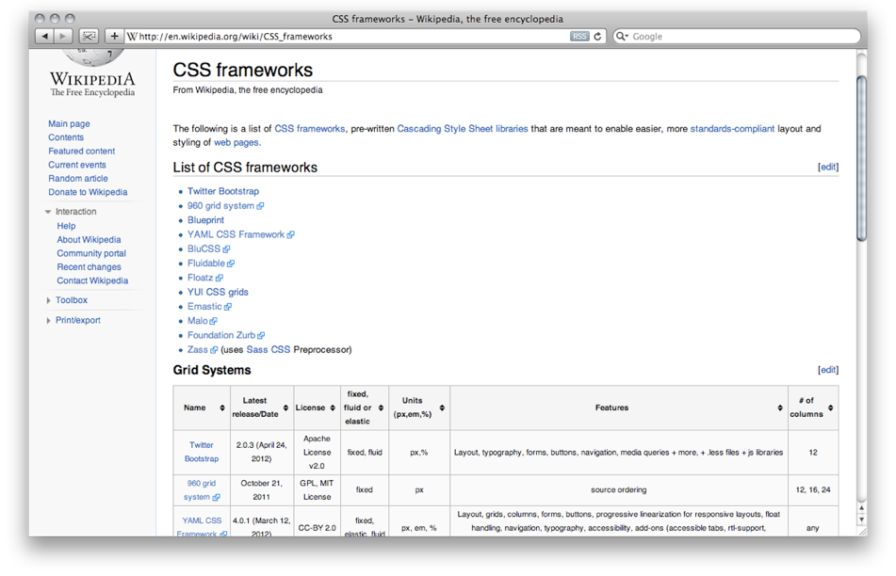

Slide 111
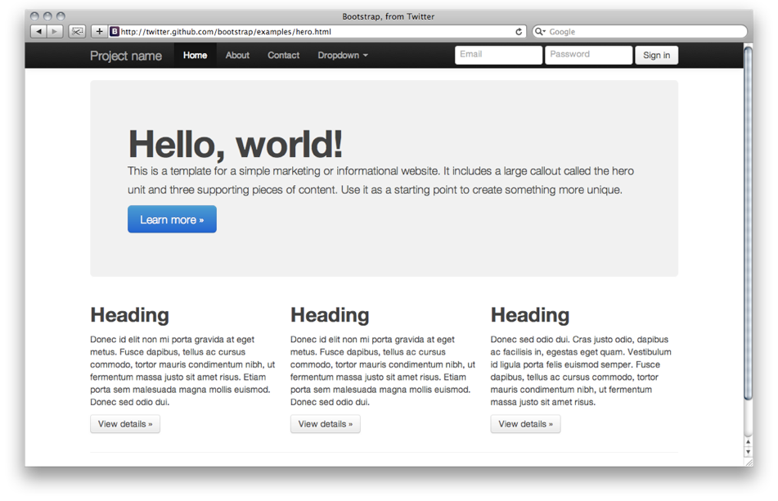

Slide 112
Keep learning

Slide 113
Questions?

Slide 114
Thank you!
@hiteatech

